Slide 1

SOC Virtual Lab
By Gabriel Antonio Zepeda

Slide 2
Table of Contents
SOC Analyst
Project - Security Operations Center (SOC) Virtual Lab

Slide 3

SOC Analyst

Slide 4


SOC Analyst
A SOC Analyst (Security Operations Center Analyst)
A cyber security professional responsible for
Monitoring,
Detecting
Investigating
Triage security incidents within an organization.
They work inside a Security Operations Center (SOC), which is the command hub for defending an organization’s digital infrastructure.

Slide 5
Why Cybersecurity
Rationale
Digital Detective
Flexibility & Growth
Engaging
As a cyber threat hunter the idea of protecting people & organizations appeals to me. A clear sense of mission.
High demand / job security with a large range of roles and opportunities. 1000+ jobs daily.
The real incidents which happen keep the job dynamic, no two incidents will be truly the same.

Slide 6
Project
SOC Virtual Lab
A simulated security operations environment

Slide 7
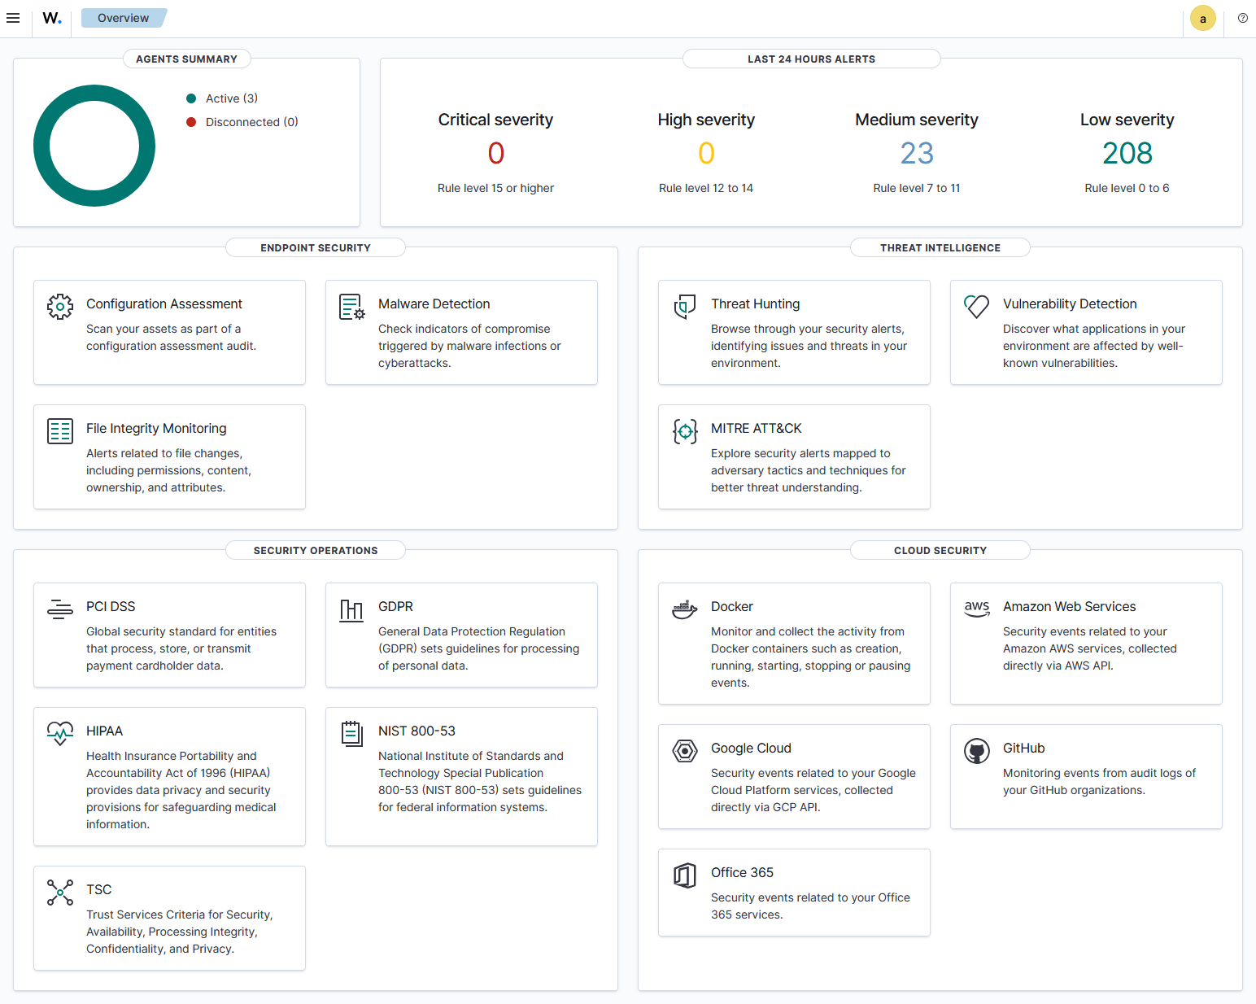
Project
What is a Virtual Lab?
The goal is to create a virtual environment which can be used to test multiple simulated attacks. Mainly for learning purposes and mastery of malicious attacks, detectionm, and remediation techniques.

Slide 8
Project
Key Concepts
Virtual Machines & Operating Systems
Security Information Event Managers
Malicious Attack Vectors & Techniques
- Rulesets - Correlation - Playbooks
SOC Report Documentation
Digital Forensics & Attacker Timelines (TTP)

Slide 9
Project
Schedule
May
June
July
August
September
October
PHASE 1
June 5th - August 20th
Task 1 – Attack Vectors
June 5th – June 9th
Task 2 – SIEM Rulesets
July 7th – July 10th
PHASE 2
Task 1 – Automated Correlation
Aug 25th – Oct 9th
Aug 25th - Aug 28th
Task 2 – Playbooks
Aug 25th – Oct 2nd

Slide 10
Project
Research
Testing
Analysis
Documentation
Deciding ADR and simulated attacks
Implementing my lab, simulated attacks, and SIEM software
Compile logs, establish rulesets, and playbooks
Create a professional report on each attack vector based on industry standard legal and ethical compliance

Slide 11
Project
Tools
- Wazuh & Wazuh Agents
- MISP
- OpenCTI
- Docker Desktop
- Virtualbox
- MemoryCapture, Volatility3
- Nmaps, Wireshark, Zeek
- HydraX, Randomeware ParrotOS SeToolkit, Python Scripts

Slide 12
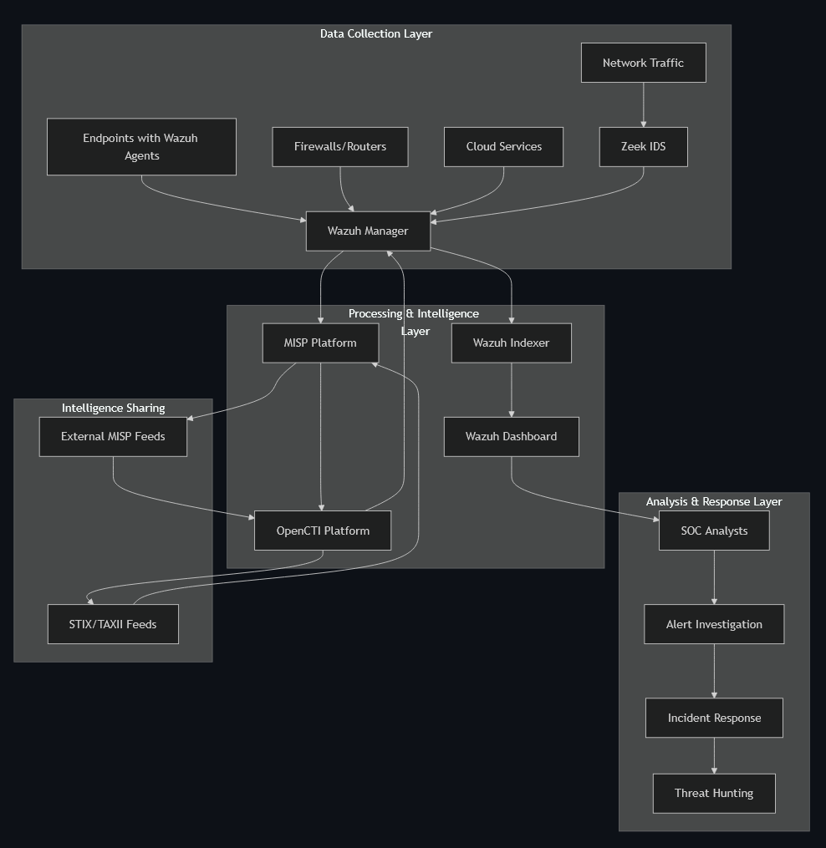
Project

Slide 13
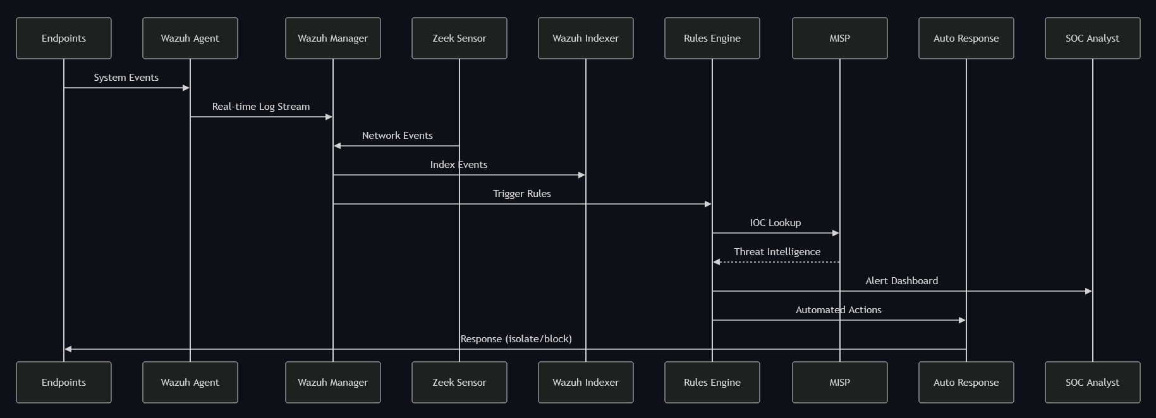
Project

Slide 14
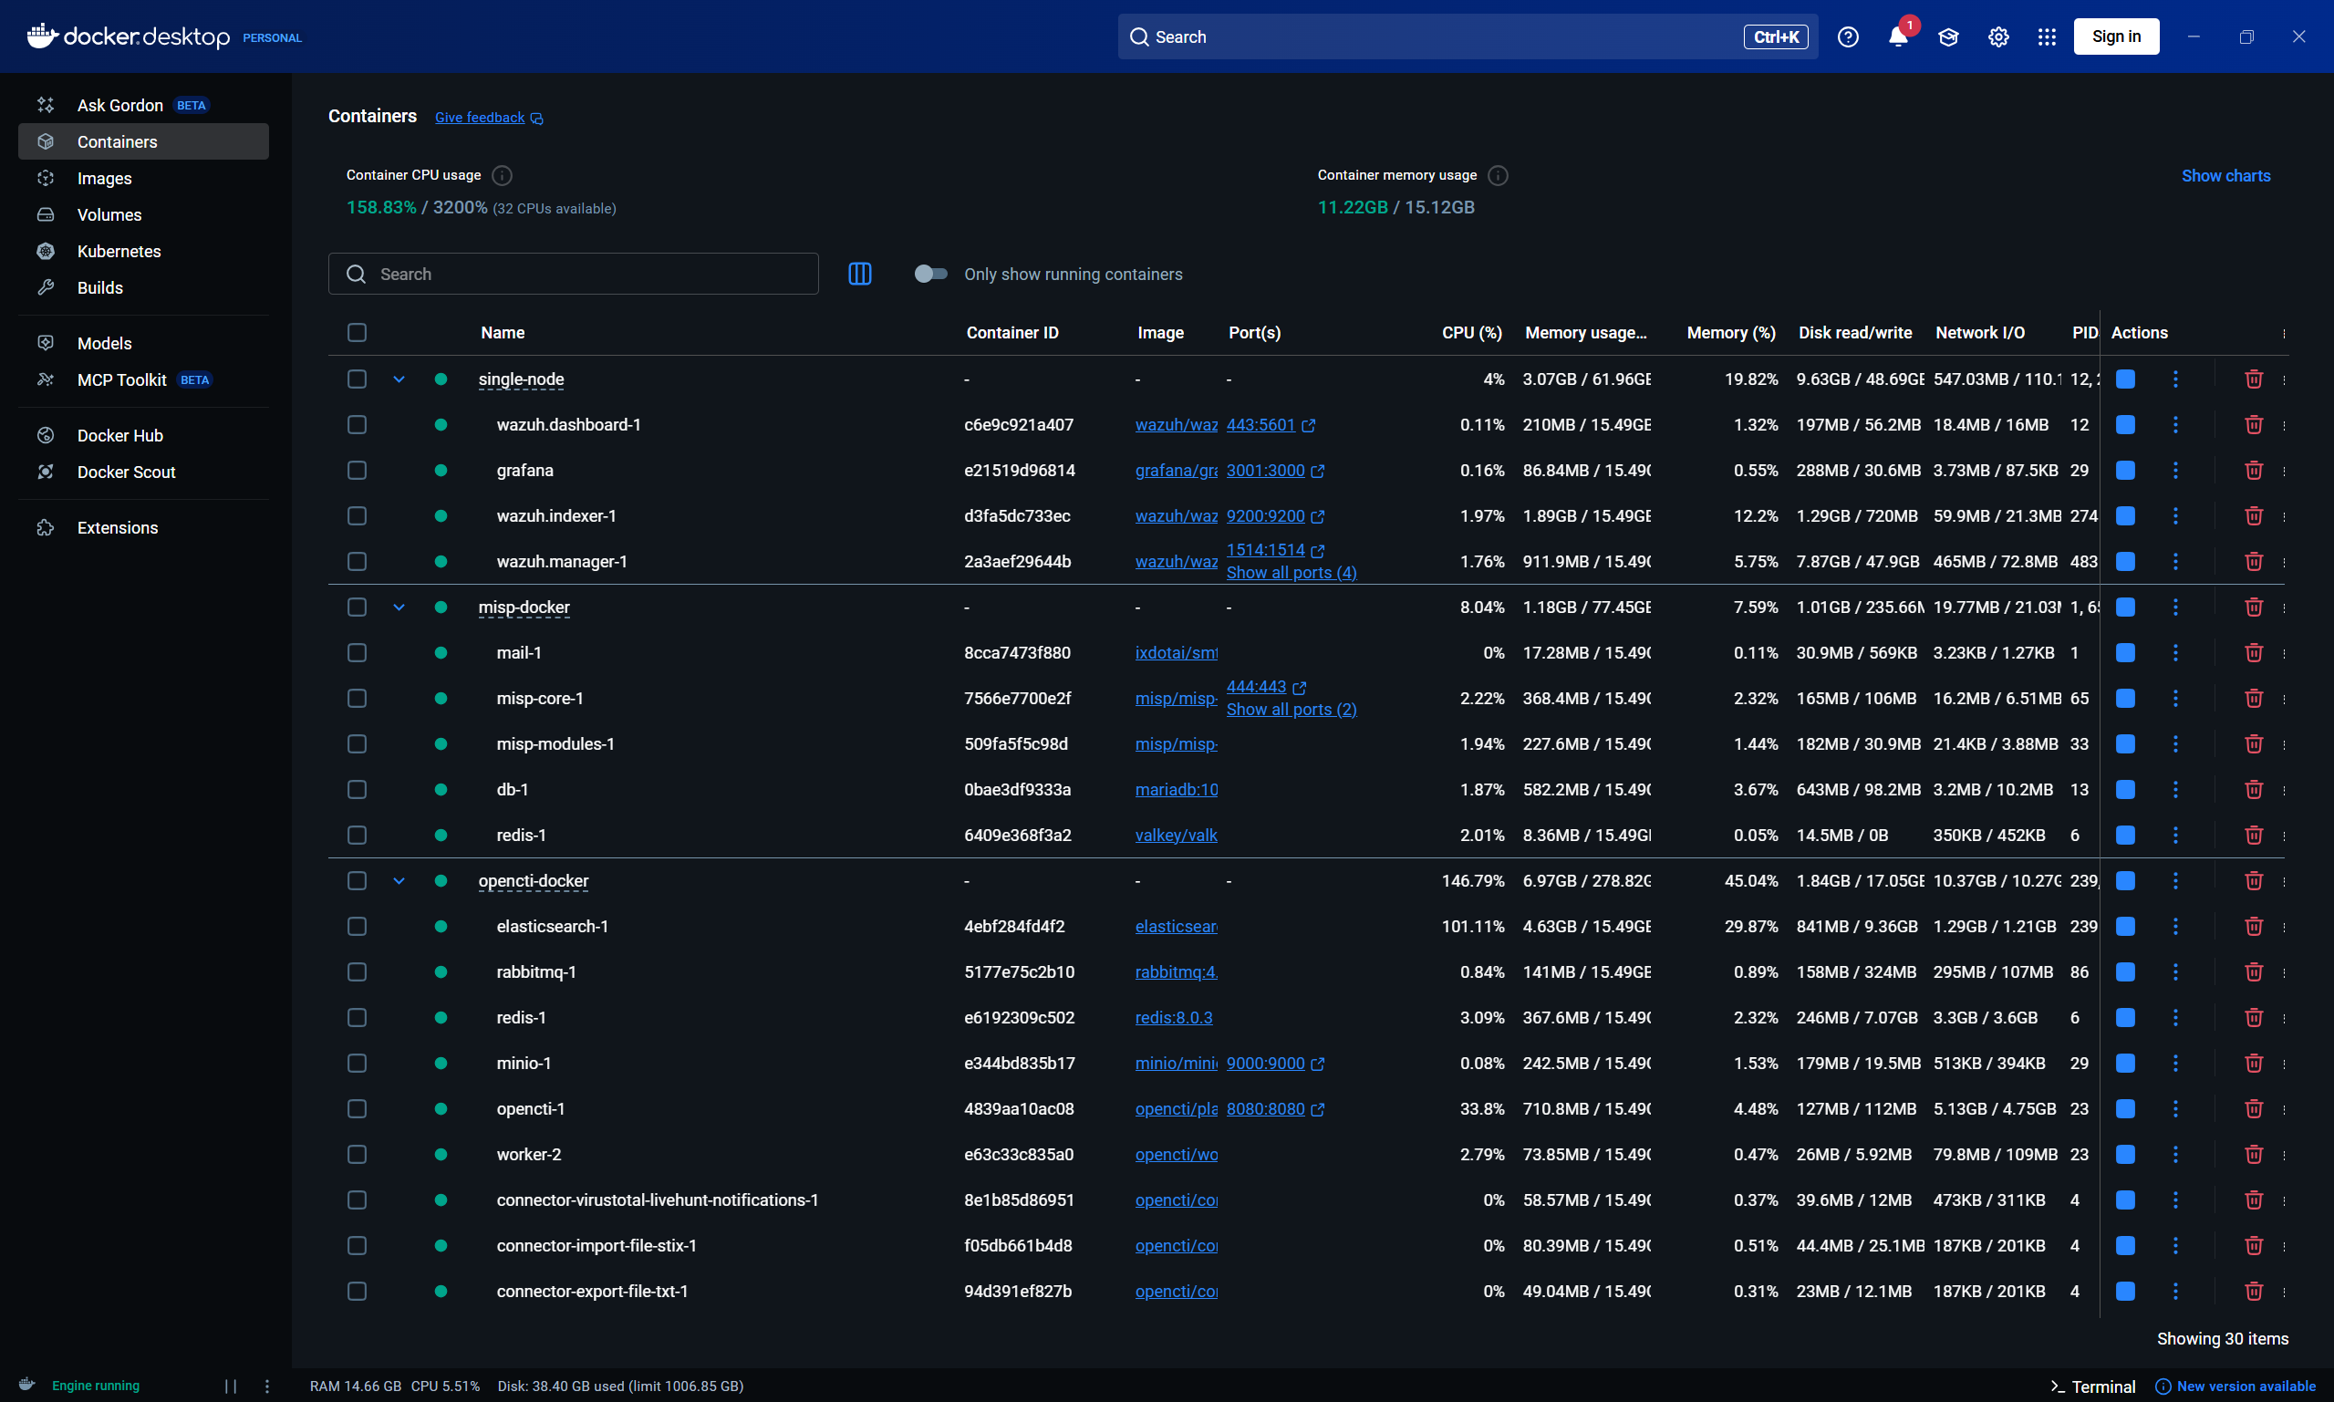
Project

Slide 15
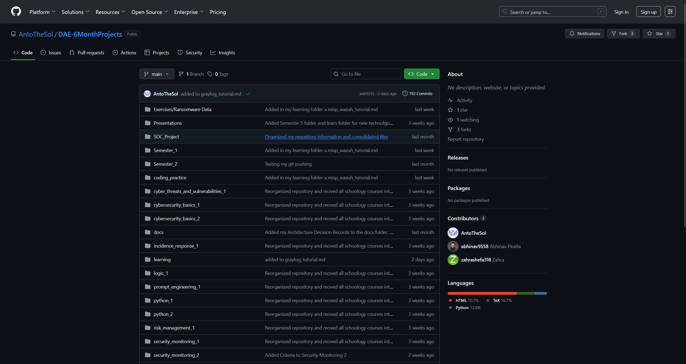
Project

Slide 16
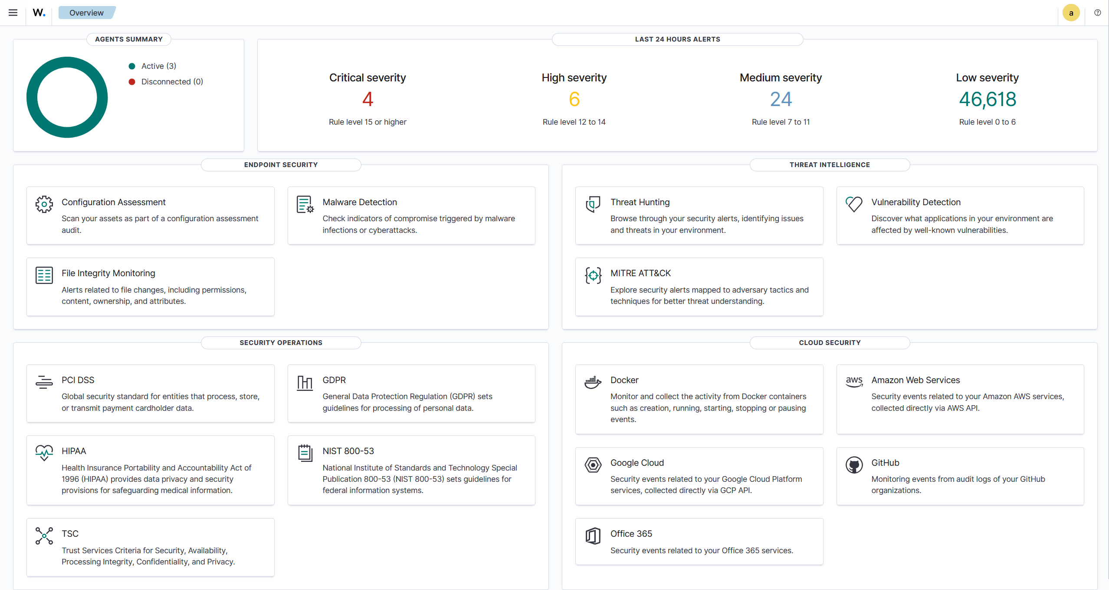
Project

Slide 17
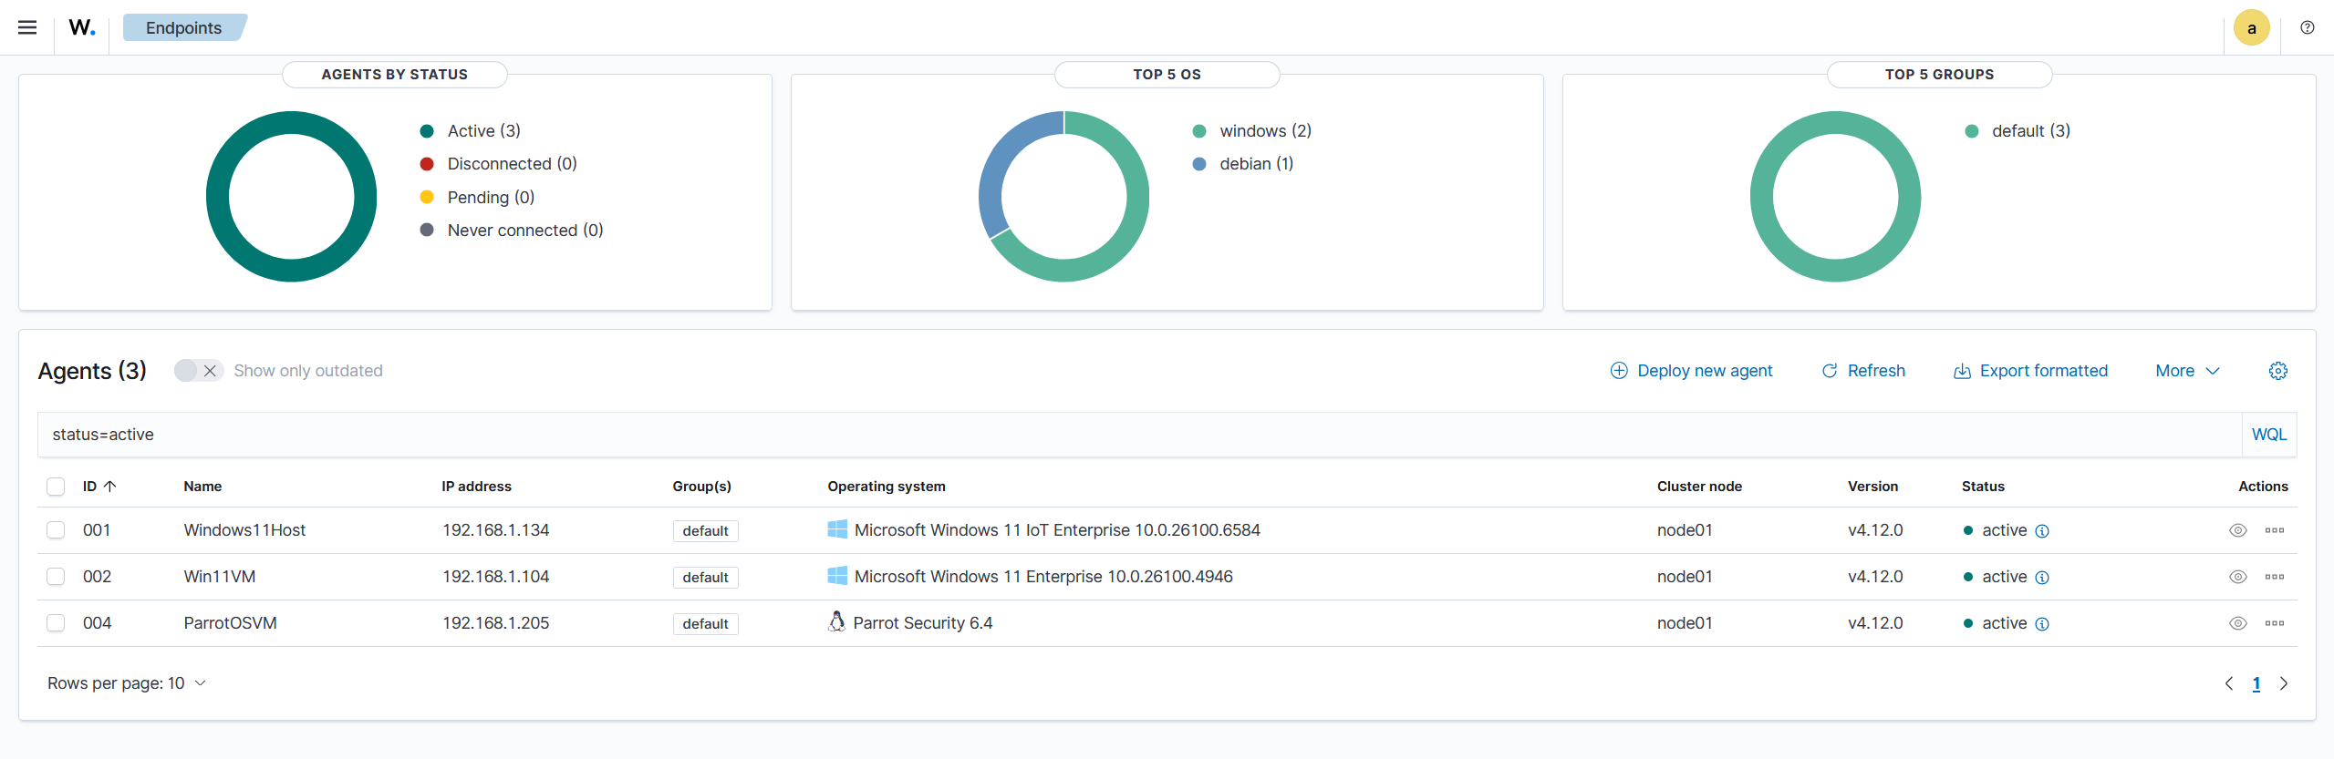
Project

Slide 18
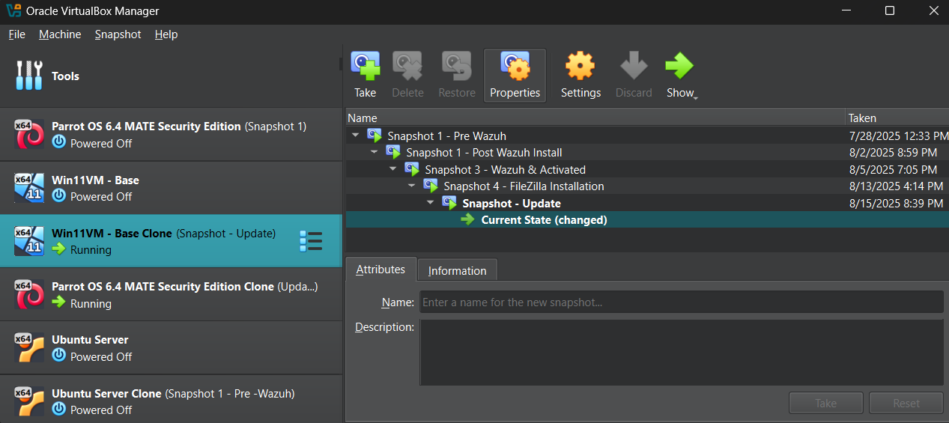
Project

Slide 19
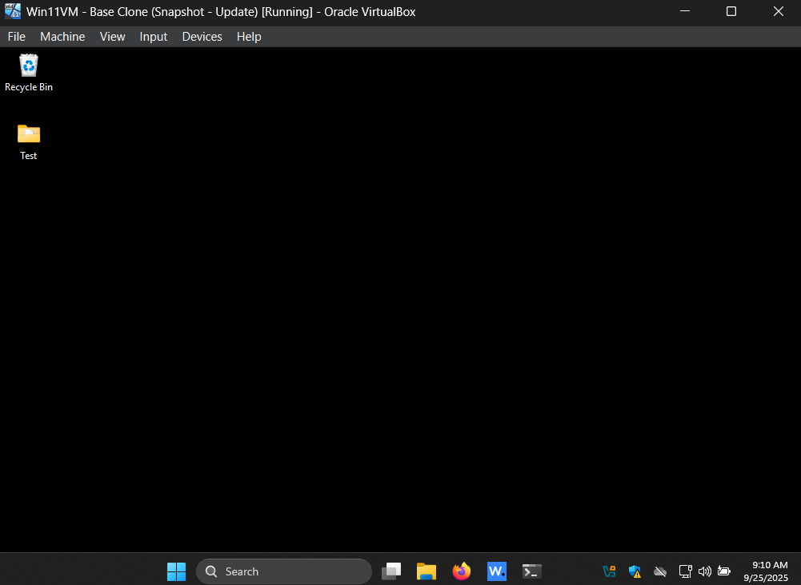
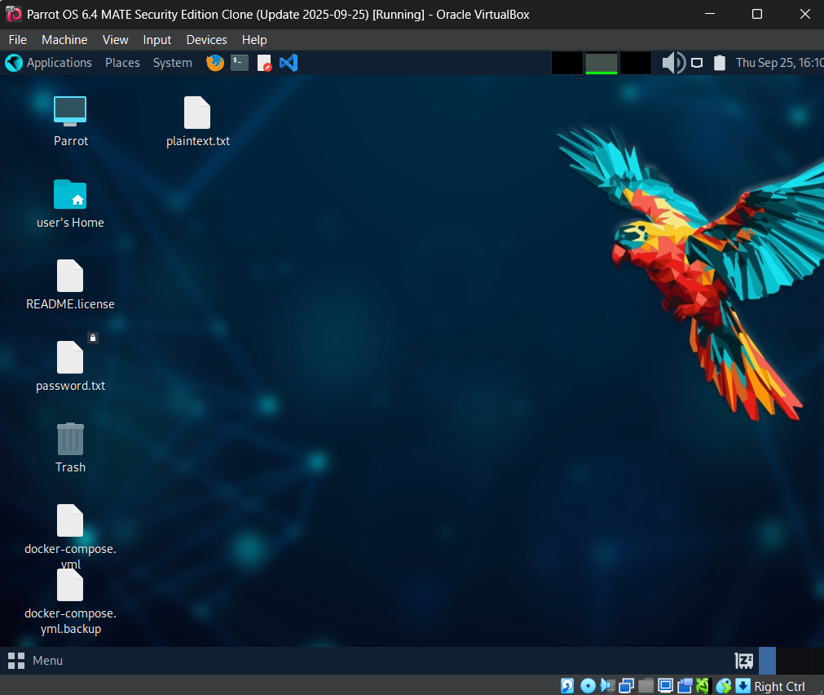
Project

Slide 20
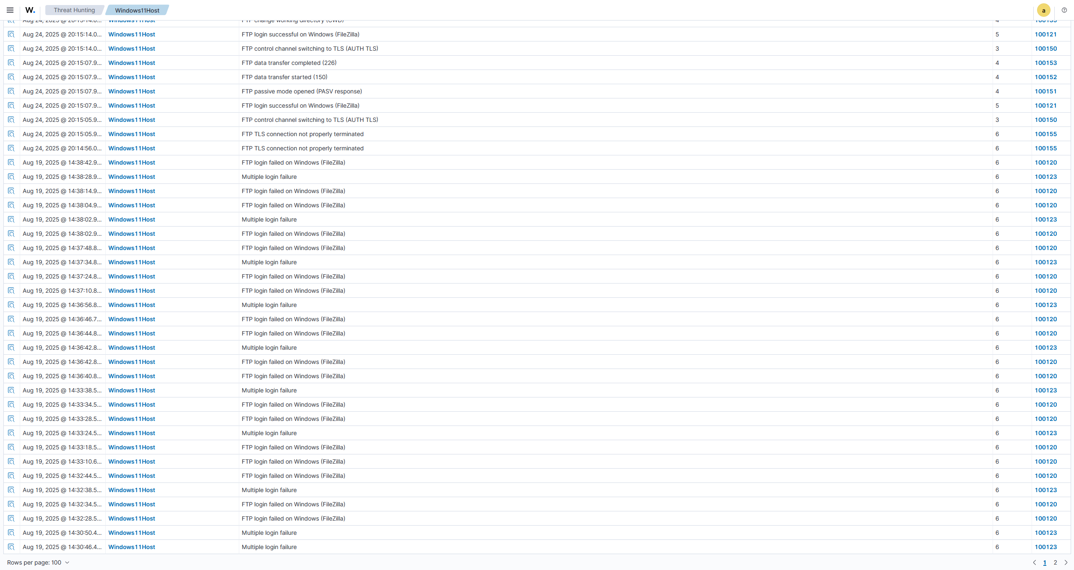
Project

Slide 21
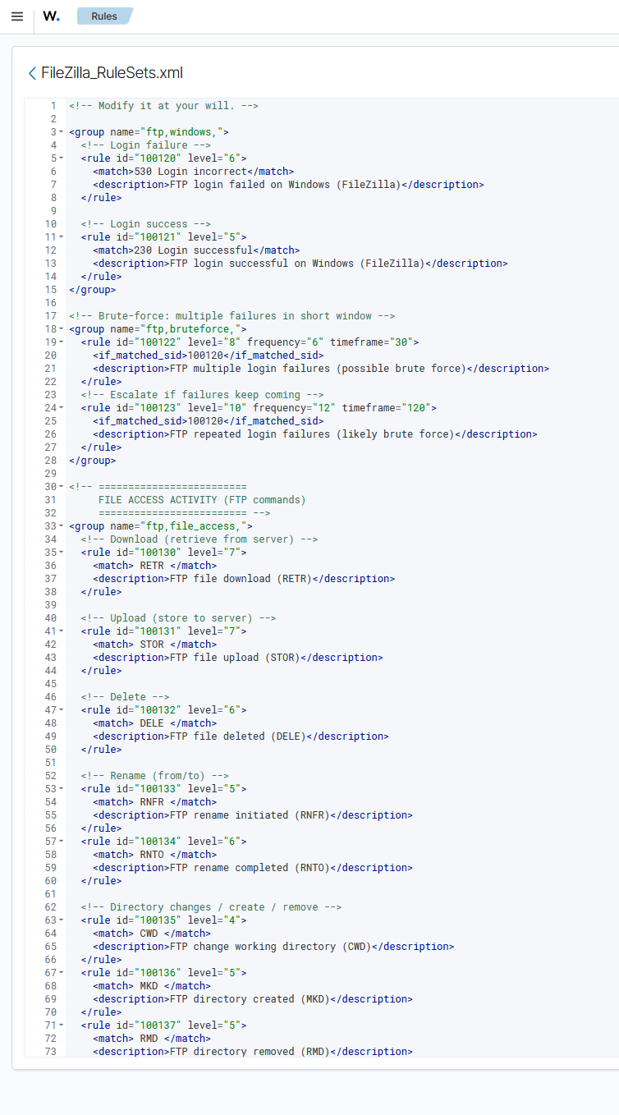
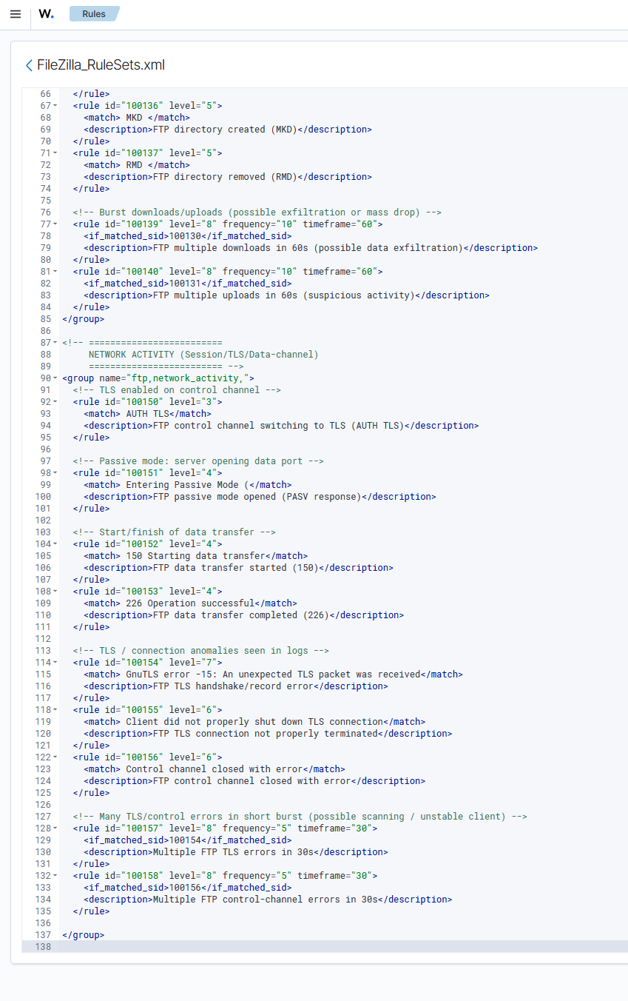
Project

Slide 22
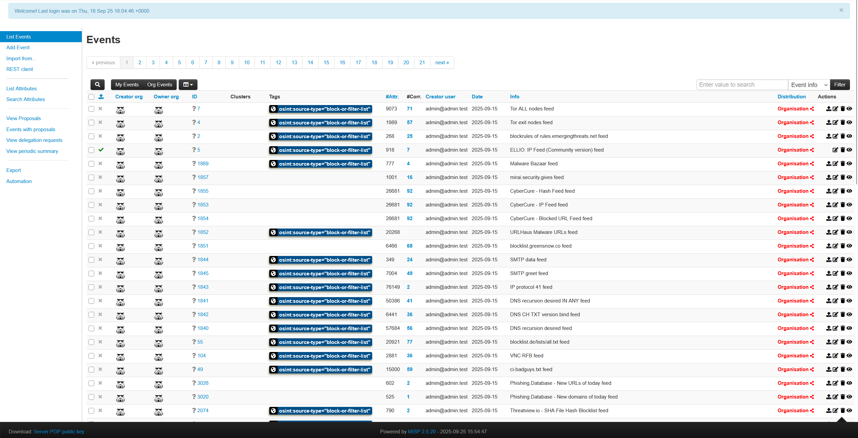
Project

Slide 23
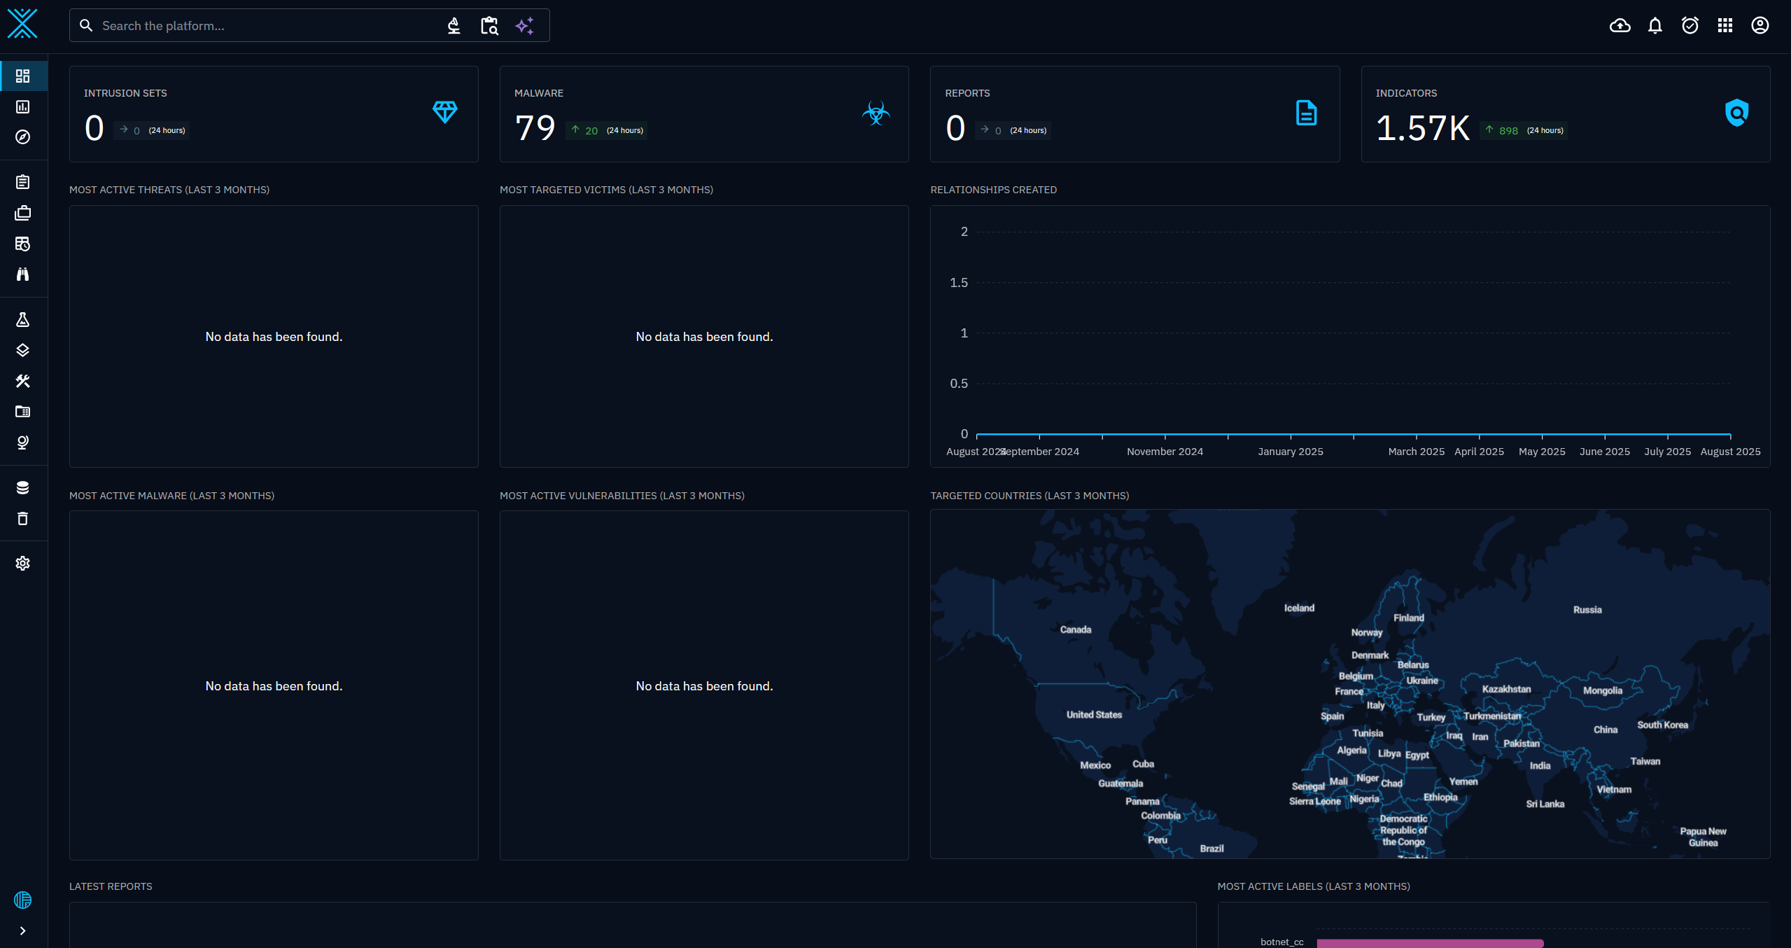
Project

Slide 24
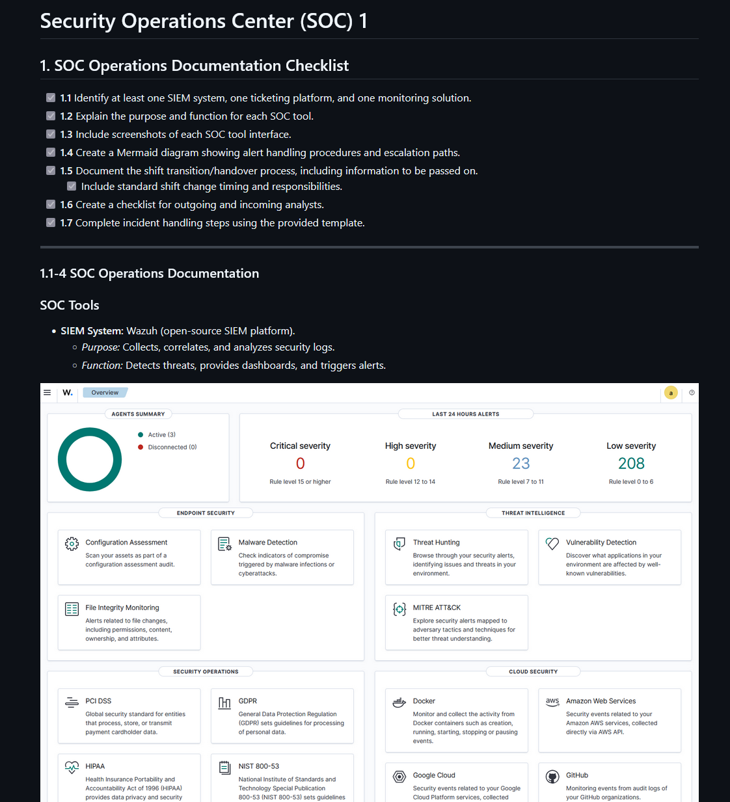
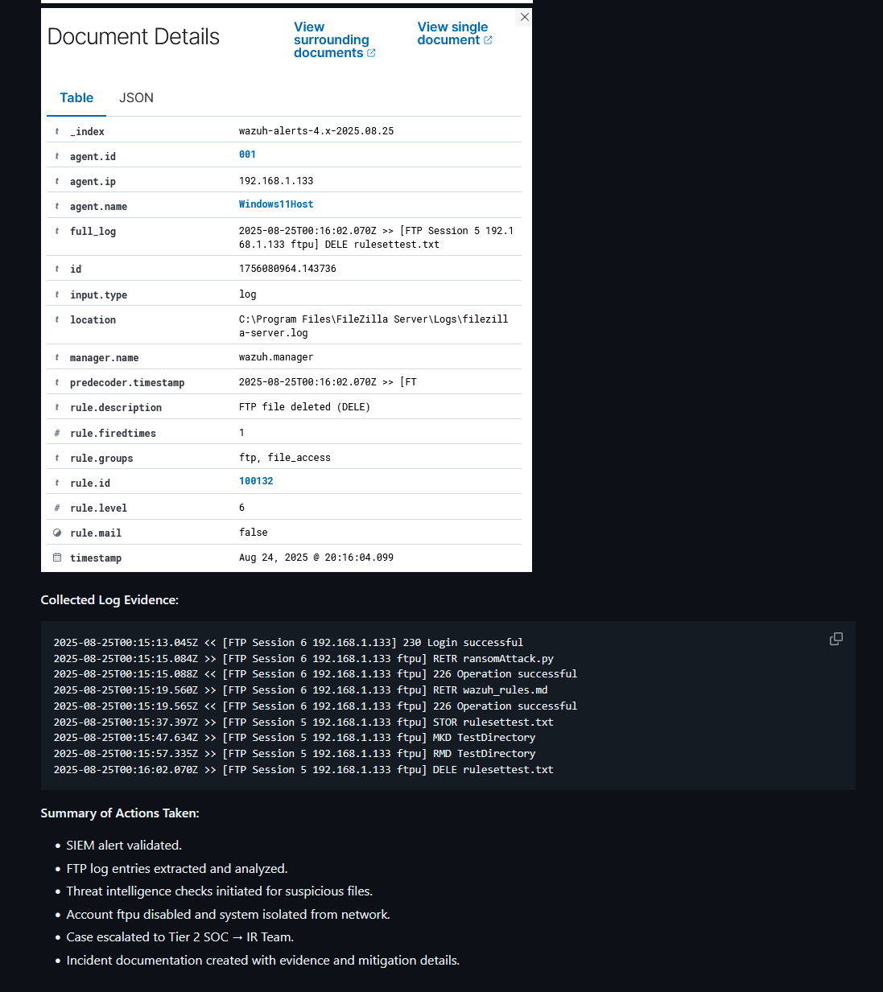
Project

Slide 25

Thanks!
Thank You!

